Slide 1
Random Forest

Slide 2
Contents
What is Bagging
What is Random Forest
How Random Forest Works
Advantages
Disadvanatges.

Slide 3
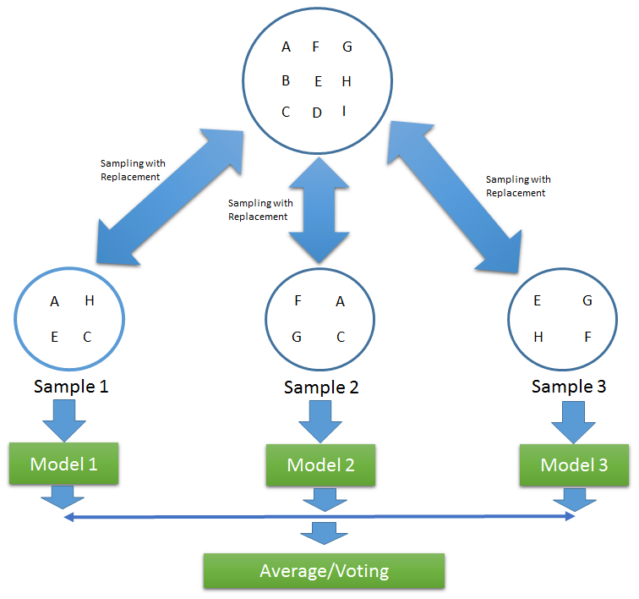
What is Bagging?
Before jumping to Random Forest, let’s study something called as Bagging.
Bagging works in three steps:
Main data set is broken down to multiple sub-
sets. These sub-sets can have fraction of rows and
columns from main data set.

Slide 4
Cont….
We then build a classifier for each of the sub-set.
Finally, we combine the result of all classifier and assign the label to the object.
If the target variable is categorical, we take majority of the votes to assign the class, if it’s a numerical variable, we take average of all the models.
Bagging is one of the techniques we can use to overcome the problem of overfitting in decision trees.

Slide 5
What is Random Forest
Random Forest works based on the principle of Bagging that we just saw.
One major disadvantage of decision tree makes way for Random Forest.
Decision tree tends to over-fit the data in most of the cases, unless we take some measures like pruning e.t.c.
Random forest works based on what we call votes.
At a high level, we can say that Random forest is a collection on decision trees, and based on the votes by all trees, we assign an object to a class(label).

Slide 6
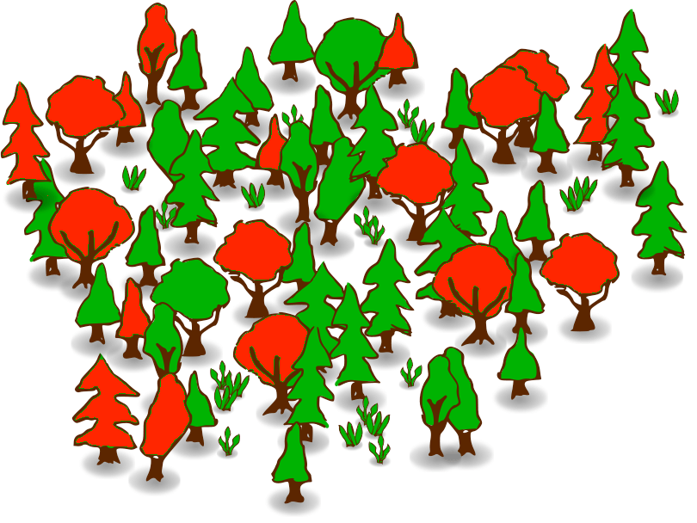
Cont….
Random forest again can be used for both classification and Regression problems.
Random forest can be considered as a
black box algorithm as we cannot
control on how it is trying to find the
pattern in the data.

Slide 7
How does it work?
Lets say we have a data set of N data points and P predictors.
We grow a number of trees in following manner:
From N data points we take a sample of data and from P predictors we take m predictors (m<P) and build a tree.
This step of building trees goes on till all the data points and all the predictors are used in building the trees.

Slide 8
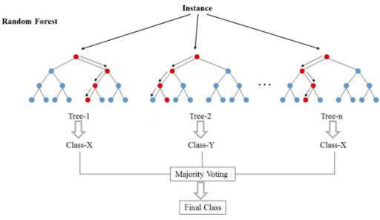
Cont….
Next, when we want to predict the class of a new data set, Random forest builds multiple trees.
Each tree assigns a class to the
data point.
Finally Random forest takes votes
from all trees and assigns the class
which has majority to the data point.

Slide 9
Advantages
Random forest can be used for both Classification and Regression cases.
If it’s a classification problem, we consider voting from all trees, if it’s a regression problem, we take average of all trees and assign the value.
Random forest helps in overcoming problem of overfitting we face in decision tree as we will be taking vote from multiple trees and not just one tree.
This algorithm is not affected by presence of outliers and missing values in our dataset to a certain extent.
Random forest is a much powerful algorithm when compared to other classifiers, as we combine the result of multiple classifiers.

Slide 10
Disadvantages
Random forest performs pretty well on Classification problems, but when it comes to regression problems, it can only predict in the range of train data set.
Random forest comparatively requires more computational power than other classifiers, as we are trying to build multiple classifiers.
The accuracy of the random forest increases as we go on increasing the number of tress (to certain extent though), but as we increase number of trees, it consumes lot of computational power and performance might be affected.
As we saw earlier, Random forest can seem like a black box algorithm as we have little control over the algorithm.

